Slide 1





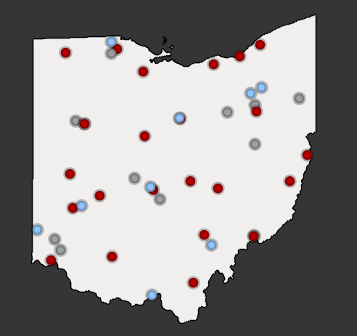




Partners in Training Ohio’s Manufacturing Workforce
Strategic Focus Areas
Ohio TechNet’s strategic focus areas provide partners with best practices, models, and technical assistance to address the critical workforce needs in the state.
OTN Members:
Community College
Technical Center
University
Guided Pathways for Youth
Reaching New Audiences
Vision
Mission
Purpose
Innovative Earn and Learn
The members of the Ohio Technical Skills Innovation Network, or Ohio TechNet, are nationally recognized for partnering with industry to implement collaborative, innovative solutions that meet manufacturing and tech workforce needs.
Ohio TechNet supports workforce development and academic professionals to incubate, develop and sustain programming that accelerates the growth of Ohio’s manufacturing & technical workforce.
Ohio TechNet partners benefit from peer-to-peer collaboration, technical assistance and access to resources, making program expansion and innovation at their institution more efficient, faster to implement and easier to sustain.
Faculty and Educator Development
Partnering with Industry

Slide 2

Would you rather…
Put your answer in the chat
MORNING
WARM UP
Would you rather go on a hayride or visit a corn maze?
Would you rather have pumpkin spice all year round or peppermint all year round?
Would you rather attend a haunted house or gather for a bonfire?
Apple cider donuts or pumpkin bread?
Notes:
Would you rather sit by the pool or swim in the ocean?
Would you rather eat s’mores or eat ice cream all summer long?
Would you rather get a terrible sunburn or get stung by a jellyfish?
Would you rather stay at a luxury resort or at a cabin in the woods?

Slide 3

Upcoming Conferences & Meetings
Faculty Feedback Opportunity
Ohio Talent Development Network (OTDN) Overview
OTN Project Updates
Partner Open Discussion

Slide 4

September Newsletter
https://campaignlp.constantcontact.com/em/1123965953934/b69cd8b7-849b-43d2-b6d4-b3fd171e65f5
Includes upcoming workforce conferences in Ohio, national conferences, and recent successes.

Slide 5
OSCN: Faculty
Feedback Opportunity

Slide 6

Ohio Talent Development Network(OTDN)
Chris Wenz
Director
Ohio Talent Development Network Resource Center
(OTDN RC)

Slide 7
Agenda:
What is the Ohio Talent Development Network (OTDN)?
Mission
History
Structure
Staff and Contact Information
Advisory Committee
Member Schools
Open Enrollment
Vendor – Products and Services
Professional Development
Questions?
Notes:
Focus on vendor products & services for individuals & how these are currently used by member schools

Slide 8

OTDN Mission:
We are a state-wide workforce development system that helps:
Individuals: Earn industry recognized certifications through education and testing
Businesses and Organizations: Hire, develop and promote the right persons
Member Schools: Access products/services from leading national and international human capital development companies, at affordable prices

Slide 9
History
2009
2016
2006
2000
2001
2004
2023
2000: LCCC receives grant from ODHE (Ohio Dept. of Higher Education) (formerly Ohio Board of Regents) to research talent development products & services offered at two-year colleges
2001: ODHE funds creation of SkillsMax Resource Center and 10 colleges launch SkillsMax Centers
2004: SkillsMax Centers increase to 20
2006: ODHE funding begins to decrease each year
2009: ODHE funding ends, 3 other Resource Centers cease operations; Ohio Technical Centers (OTCs) (formerly Adult Career Centers) move from reporting to Ohio Department of Education to ODHE; SkillsMax evolves into USO TDN (University System of Ohio Talent Development Network), a membership organization open to two-year colleges and OTCs, funded by membership fees and a direct customer contract
2016: Name change to Ohio Talent Development Network (OTDN), 48 Ohio public two-year colleges and OTC members
2019: Implementation of transaction fees to help sustain the OTDN
2020: Membership expanded to include Ohio public universities
2021: Shawnee State University joins the OTDN
2023: OTDN expands to 51 members
2025: Central Ohio Technical College joins the OTDN

Slide 10
Since 2001, the Network…
Served 1000+ Corporate and State Agency Clients
Profiled over 500 jobs across numerous industries
Delivered more than 415,000 assessments, 109,000 Certifications (primarily IT), and 29,000 GED Tests
Helped over 134,821 Ohioans earn ACT WorkKeys’ National Career Readiness Certificate (NCRC)
  461 Platinum
  29,226 Gold
  83,556 Silver
  21,578 Bronze
Verifies individuals are “work ready” & have essential core employability skills (Applied Math, Graphic Literacy, and Workplace Documents)

Slide 11
Ohio Talent Development Network (OTDN)
LCCC
Vendor
Partners
ODHE
Member
Schools
OTDN
Resource
Center
The OTDN, supported by the OTDN Resource Center located at Lorain County Community College (LCCC) and in collaboration with the Ohio Department of Higher Education (ODHE), brings together vendor partners of human capital development tools. Member schools deliver products and services to create tailored solutions for employers, educational institutions, individuals and government entities at affordable prices.

Slide 12
OTDN Resource Center
Contact Information
ohiotalent@lorainccc.edu
440-366-7679
Chris Wenz
Director
OTDN Resource Center
cwenz@lorainccc.edu
Alison Church
Project Coordinator
achurch@lorainccc.edu

Slide 13
OTDN Advisory Committee Members
Krista Richardson
Director Workforce and Community Engagement – Career Development
Rhodes State College
Anne Bowman
Coordinator, Assessment and Talent Management
Career & Technology Education Centers
(C-TEC )
Erika DeBorde
Senior Operations Manager
Sinclair Community College
Roe Schroeder
Assessment Center Coordinator
Warren County Adult Technical Center
Mike Augenstein
Director of Workforce Solutions
Marion Technical College
Sandy Elliott
Career Technical Supervisor
Wayne County Schools Career Center
Ex-Officio
John Magill
Associate Vice Chancellor
Economic Advancement
Ohio Department of Higher Education (ODHE)

Slide 14
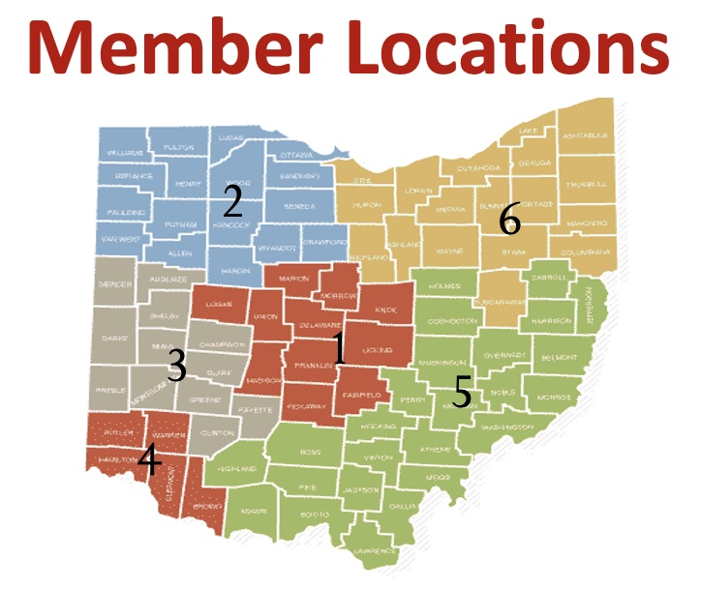
CENTRAL REGION (1)
Central Ohio Technical College IIC
Columbus City Schools IIC
Columbus State Community College IB
Career and Technology Education Centers of Licking County (C-TEC) IB
Delaware Area Career Center IIC
Eastland Fairfield Career &Tech IA
Marion Technical Center IIA
Ohio Central School System IIB
Tolles Career & Technical Center IIC
Tri-Rivers Career Center IIC
NORTHWEST REGION (2)
Apollo Career Center IIC
Four County Career Center IIB
Penta Career Center IIC
Rhodes State College IB
Vantage Career Center IB
WESTERN REGION (3)
Clark State Community College IB
Sinclair Community College IB
Upper Valley Career Center IB
SOUTHWEST REGION (4)
Butler Tech & Career Development Schools IB
Cincinnati State Tech College IIC
Great Oaks Career Campuses IIC
Miami Valley Career Tech Center IA
Brown & Clermont Adult Career Campuses Center) IIC
Warren County JVS IB
SOUTHEAST REGION (5)
Belmont College IB
Buckeye Hills Career Center (Gallia-Jackson Vinton JVS) IIC
Mid-East Adult Center for Education IIB
Pickaway-Ross Career & Technology Center IB
Pike County Career Tech Center IIC
Scioto County Career Tech Center IIC
Tri-County Career Center IB
Washington County Career Center IB
Washington State Community College IIA
NORTHEAST REGION (6)
Auburn Career Center IIC
Buckeye Career Center IB
Columbiana County Career & Tech Center IIB
Cuyahoga Valley Career Center IIC
EHOVE Career Center IB
Lakeland Community College IIA
Lorain County Community College IB
Lorain County JVS Adult Career Center IIB
Madison Adult Career Center IIC
Mahoning County Career & Technical Center IIC
North Central State College IB
Ohio State University-ATI IIA
Pioneer Career & Tech Center IIC
Polaris Career Center IIC
Sandusky Career Center IIC
Trumbull Career & Tech Center IB
Wayne County Schools Career Center IB

Slide 15













OTDN Overview
Ohio Talent Development Network
provides a variety of “Best in Class” national
and international vendors to supply top notch
talent development services to individuals and employers at affordable prices.

Slide 16
Vendor Partners
WorkKeys
Big 3 Assessments – Applied Math, Graphic Literacy and Workplace Documents -used to determine ability to succeed in training programs
Measures the foundational skills, most relevant across industries and occupations
Below minimum scores – remediation before entrance
Students can earn the National Career Readiness Certification (NCRC) based on their scores
Due to high volume of testing- OTDN members have the lowest pricing across the country!

Slide 17

Vendor Partners
WorkKeys Curriculum
Training software to help students master the skills assessed in many of ACT assessments
Students can earn a higher level NCRC
Schools can purchase an annual license for their students
OTDN discounted price: $1,750.00 (includes all Course Bundles and Essential Skills)
Priced as high as $3,000.00!

Slide 18
Vendor Partners
ACT WorkKeys – Job Profiling
Job profiling analyzes the tasks and skill levels for specific jobs.
By using a focus group approach, job incumbents meet with an ACT Job Profiler to link job tasks with ACT WorkKeys Assessments.
Profiling brings the specifics of the job into focus and pinpoints the benchmarks for hiring at the correct skill level.
Establishes content validity reports for the WorkKeys Assessments use in the company when making selection, advancement, and training decisions.

Slide 19
Membership Open Enrollment
Annual Renewal
  Open Enrollment – May – June each year
    Period for schools to decide level to enroll in or change levels
      Open to existing and new qualified schools
    Complete:
    Open Enrollment Membership/Change Form
    Memorandum of Understanding (MOU)
    New members can join any time (on a pro-rated basis)!
Membership Period: July 1 – June 30

Slide 20

Vendor Partners
Certiport, a Pearson VUE business, was established in 1997 and is now the leading provider of certification exam development, delivery, and program management services. Certiport exams are delivered through an expansive network of over 14,000 Certiport Authorized Testing Centers worldwide.
Certiport delivers more than three million exams each year through the secondary, post-secondary, workforce, and corporate technology markets in 148 countries and 26 languages.
OTDN Discount:
10% discount on all certification exams
Free exams and training for instructors

Slide 21
New Certifications
  Certiport –Vendor Partner
  Agriscience and Technology Careers,
  Health Sciences Careers,
  Hospitality and Culinary Arts Careers
  AI

Slide 22
Vendor Partners
The Manufacturing Skill Standards Council (MSSC), is an industry-led, training, assessment and certification system focused on the core skills and knowledge needed by the nation’s front-line production and material handling workers.
The nationwide MSSC System, based upon industry-defined and federally-endorsed standards, offers both entry-level and incumbent workers the opportunity to demonstrate that they have acquired the skills needed in the technology-intensive jobs of the 21st century. MSSC offers training programs and certifications for this workforce:
CERTIFIED PRODUCTION TECHNICIAN (CPT)
CERTIFIED LOGISTICS TECHNICIAN (CLT)
Certified LOGISTICS ASSOCIATE (CLA)
Supply chain automation technician (CT-SCA)
OTDN Discount: 25% off all training programs

Slide 23

Vendor Partners
NBS' primary products and services include:
Customized assessment services with customized delivery options
Standardized assessments in over 100 occupational areas
Written and performance assessments - paper/pencil or online
Score reporting services that provide results for each employee with comparisons at the site, state, and national level
Customized reporting services, including detailed needs analysis by competency, demographic analysis, and item level data
Services are targeted to the industrial, business, military, and municipal sectors and are typically used for pre-hire/post-hire decision-making and training purposes. Assessment results are used to enhance information needed for decisions related to position requirements and the knowledge and skills of the individual being assessed.
OTDN Discount: 40% off all assessments

Slide 24
New Certifications - Opportunities
  Nocti Business Solutions –Vendor Partner
  Career Technical Education(CTE) instructor, administrator, work based learning certifications
  Earn $60.00 to proctor Nocti’s Prior Learning Assessments(PLA)
  Reach out to Kay Cole: kay.cole@nocti.org for details
  Earn 5% cash back for your school by referring customers to Nocti to develop customized assessments
  Approximately $1,000-$1,250

Slide 25

Vendor Partners
Certification is the principle method by which the IT profession gives formal recognition to an individual who has demonstrated his or her competence in a defined area of specialization in the IT professional field.
Certifications and licenses enable employers to determine who has the skills to perform their functions.
3,400+ Pearson VUE Authorized Test Centres worldwide
Choose from more than 2,100 exams from 61+ sponsors
Exams available in
  145 countries
  24 languages
Exams include:
  Ohio Assessment for Educators
  Computer Based Testing – G.E.D.
  CompTIA- A+ and much more!

Slide 26

Vendor Partners
Ramsay Corporation is a leader in the creation and validation of tests for skilled technicians. They have over 35+ years of test development experience to create a series of off-the-shelf testing products to assess maintenance, production, and operator workforces.
The off-the-shelf tests are suitable for pre-employment assessment or pay-for-knowledge programs and can be used when custom validation is not required.
Tests available in paper and pencil and online formats.
Members can order less than the 20-test minimum.
OTDN Discount: 10% off all assessments

Slide 27
Vendor Partners
Leading international test publisher/human capital consulting firm located in the UK.
Types of tests:
Personality & Behavior, Cognitive Abilities/Aptitude, Knowledge, Skills & Abilities
Extensive assessment catalog
Assessment fact sheets
Sample reports
Marketing materials
OTDN Benefit: No Need for $1,000.00 upfront purchase

Slide 28
New Assessments
  SHL – Vendor Partner
AI Skill Assessment
Manufacturing -Safety and Dependability, Process Monitoring and more
Management & Professional
Reskilling Potential
Global Skills Assessment – measures 96 soft skills in 15 minutes

Slide 29

Vendor Partners
Deliver background screening, onboarding and drug testing services.
Sterling Talent Solutions, formerly Sterling InfoSystems, was founded in 1975. Sterling Talent Solutions merged with TalentWise in 2016 to become Sterling Talent Solutions.
More than 2,800 employees serve over 20,000 customers around the world, including a quarter of the Fortune 100.
92% client retention rate.
Sterling Talent Solutions is the world's largest company focused entirely on background checks with offices in the United States, Canada, the U.K., India and the Philippines.
Discounts available for member schools.

Slide 30

Vendor Partners
PAN (Performance Assessment Network) – PSI, is a leader in the assessment and talent acquisition field. In 2017 PAN was purchased by PSI. 2022 name changed to Talogy.
Working with over 50 of the world’s leading test publishers, they provide a unique source of assessment tools in categories such as intelligence, personality, integrity, mechanical aptitude, IT, general skills and more.
Easy to use testing platform
Free test demos
Over 200 tests with descriptions and sample reports
OTDN Discount: Access to tests without paying the annual $2,500 license fee.

Slide 31

Vendor Partners
TRAINING AND DEVELOPMENT | toolingu.com
Versatile learning and development solutions to upskill the manufacturing workforce.
Educational institutions turn to Tooling U-SME to augment their learning plans, providing their instructors with more time for hands-on instruction.
Companies select their training & development solutions to educate their workforce, increase productivity and improve product quality.
Individuals turn to Tooling U-SME to gain new skills and advance their careers.

Slide 32
New Training Programs
  Tooling U-SME – Vendor Partner
New classes in their Workforce Essentials Department
Professional Communication Methods
Handling Interpersonal Conflict
Job Interview Preparation
Punctuality
Professional Communication Pitfalls
OTDN Discount: 12% off all training programs and 10% discount on certification exams

Slide 33
Vendor Partners
Leading provider of educational solutions for OTCs and community colleges
Specializes in Career & Technical (CTE) with hands-on training systems
Offers state-of-the-art technology in STEM, advanced manufacturing, robotics and more
Partners with top manufacturers and organizations to align education with industry needs
Supports educators with curriculum solutions, training and expert guidelines
Helps students develop real-world skills for in-demand careers

Slide 34

Vendor Partners
For nearly 50 years, Vocational Research Institute has
been helping people prepare to achieve their potential.
VRI's career assessment, planning, and training products help individuals succeed in school, work, and life. Their products promote career and transition planning and are effective in an array of settings.
CareerScope identifies the user's attraction to careers as they relate to the U.S. Department of Labor's Interest Areas and measures aptitudes that are most critical for today's high growth and high replacement occupations.
OTDN Benefit: No Need for $300.00 annual portal fee

Slide 35
Member School Comments
  Mike Freed – Senior Manager Manufacturing Solutions
  Sinclair College

Slide 36
Professional Development
  Annual OTDN-PACE Conference
  April 3-4, 2025 Embassy Suites - Dublin
  Highlights
  180 attendees from 50 schools
  9 vendor/sponsors – 7 Platinum level
  4 ODHE staff attended
  Very positive feedback from attendees and vendors!

Slide 37
Professional Development Planning Discussion
2025-2026 FY
  Follow-up to February Member School Survey
  Over 50% response rate!
  One day in-person training – Columbus area – Fall 2025

Slide 38
Professional Development Planning Discussion
2025-2026 FY
  Topics of Interest
  Building business partnerships/customized training/apprenticeships
  Funding options for customers
  Best practices from member schools
  Training from vendors
  Outside training provider
  Networking

Slide 39
the power of partnership
Driving Growth Through Employer-Education Collaboration

Slide 40
Questions?
  Contact: Chris Wenz
  Director, Ohio Talent Development Network
  Resource Center
  cwenz@lorainccc.edu
  or
  ohiotalent@lorainccc.edu
  440-366-4748
  www.ohiotalent.org

Slide 41

OTN Project Updates:
Smart Manufacturing Asset Map
Technical Calculus

Slide 42

Smart Manufacturing Asset Map
Update of 2020 Automation & Robotics asset map, incorporating state-level data and priorities
Developed in collaboration with New Growth Group, OMA, Ohio MEP, ODHE, ODEW, and ODOD
Incorporating data on:
TechCred awards
RAPIDS / Super RAPIDS investments
OTC and Higher Ed Engineering Technology enrollments and completions
County and School District level data
And more!

Slide 43
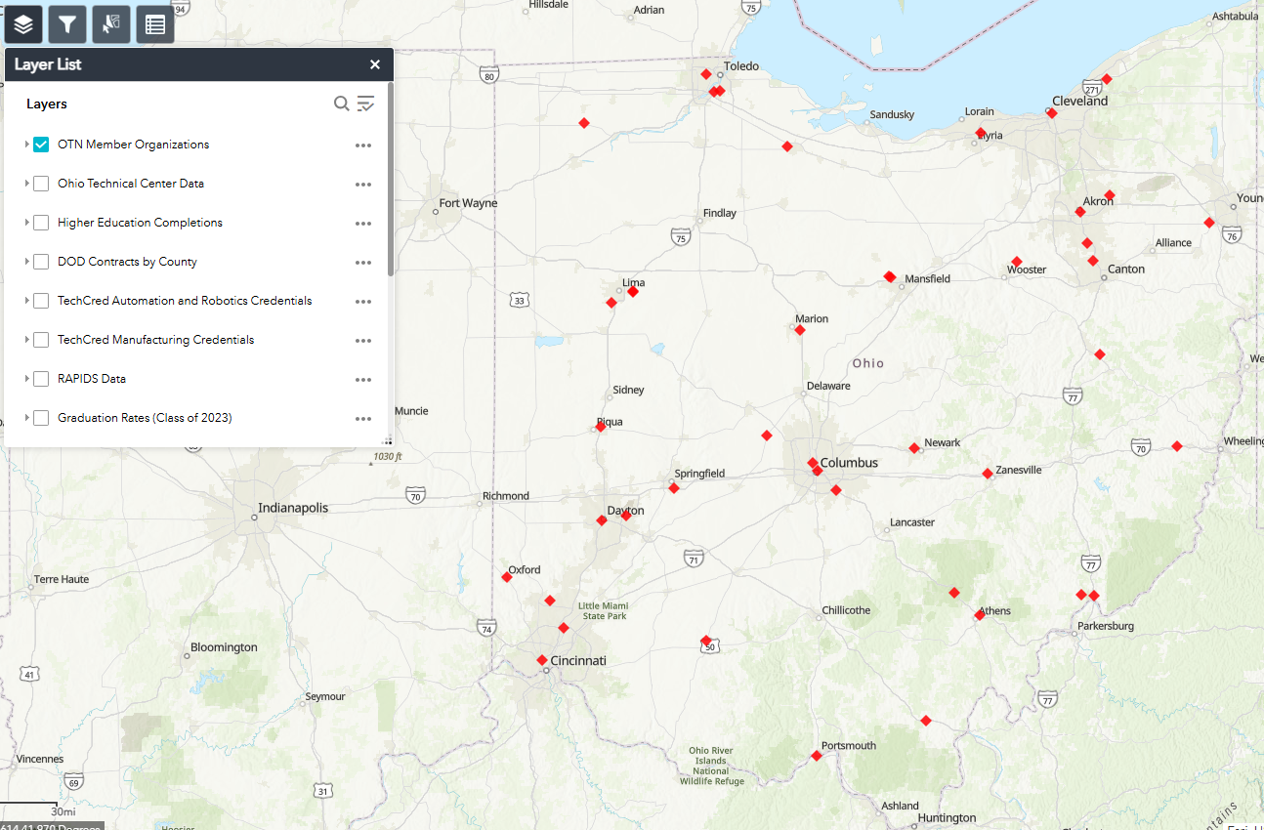

Slide 44
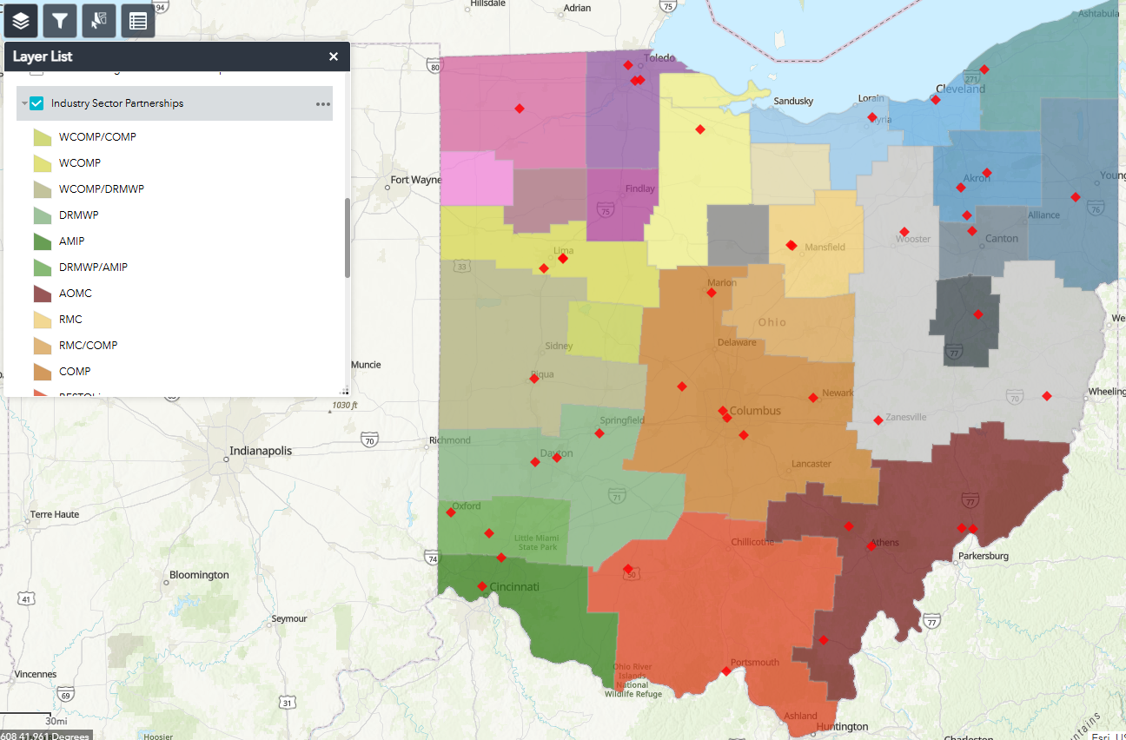

Slide 45
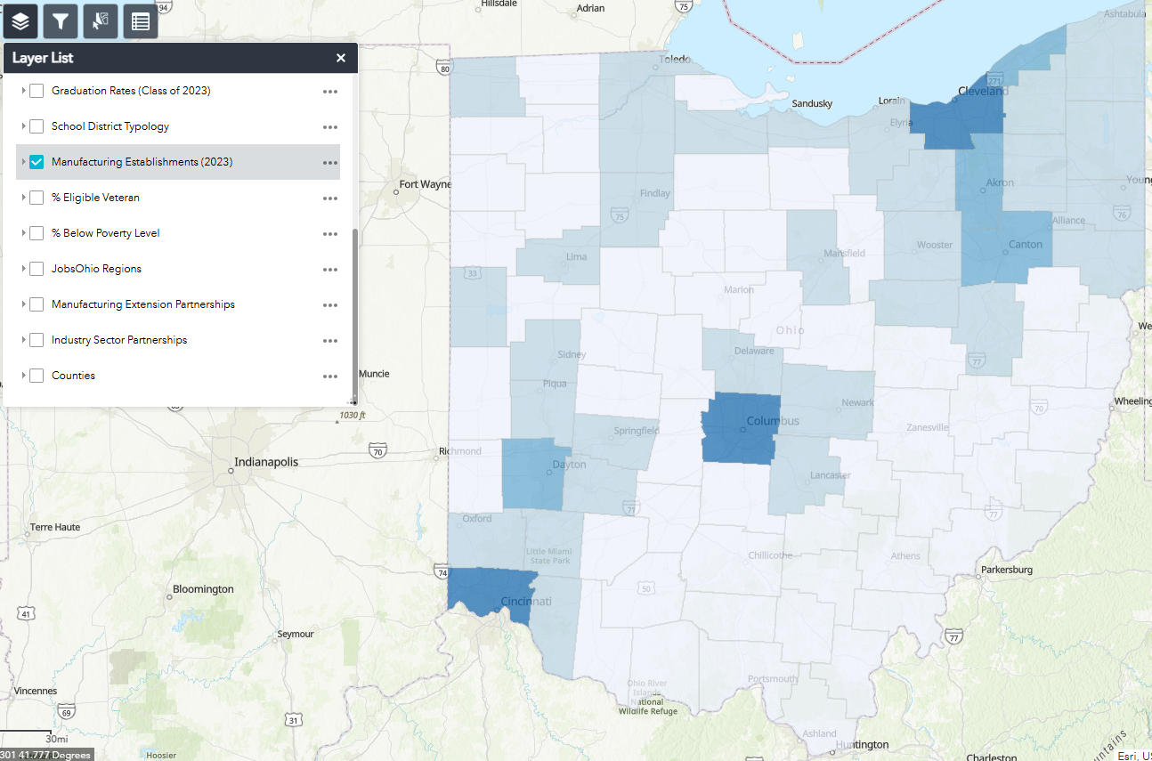

Slide 46
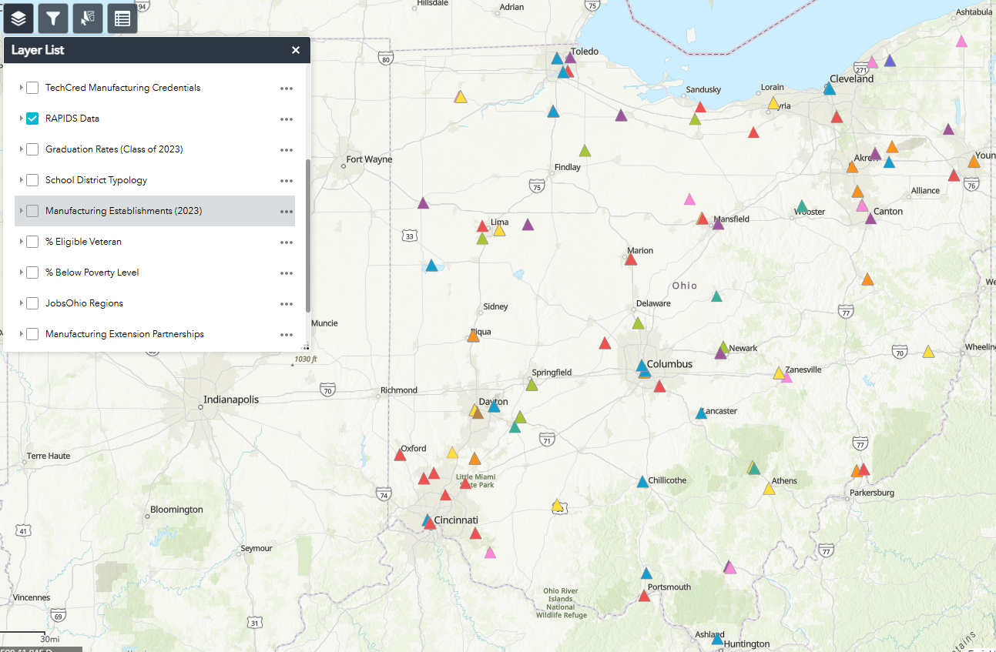

Slide 47
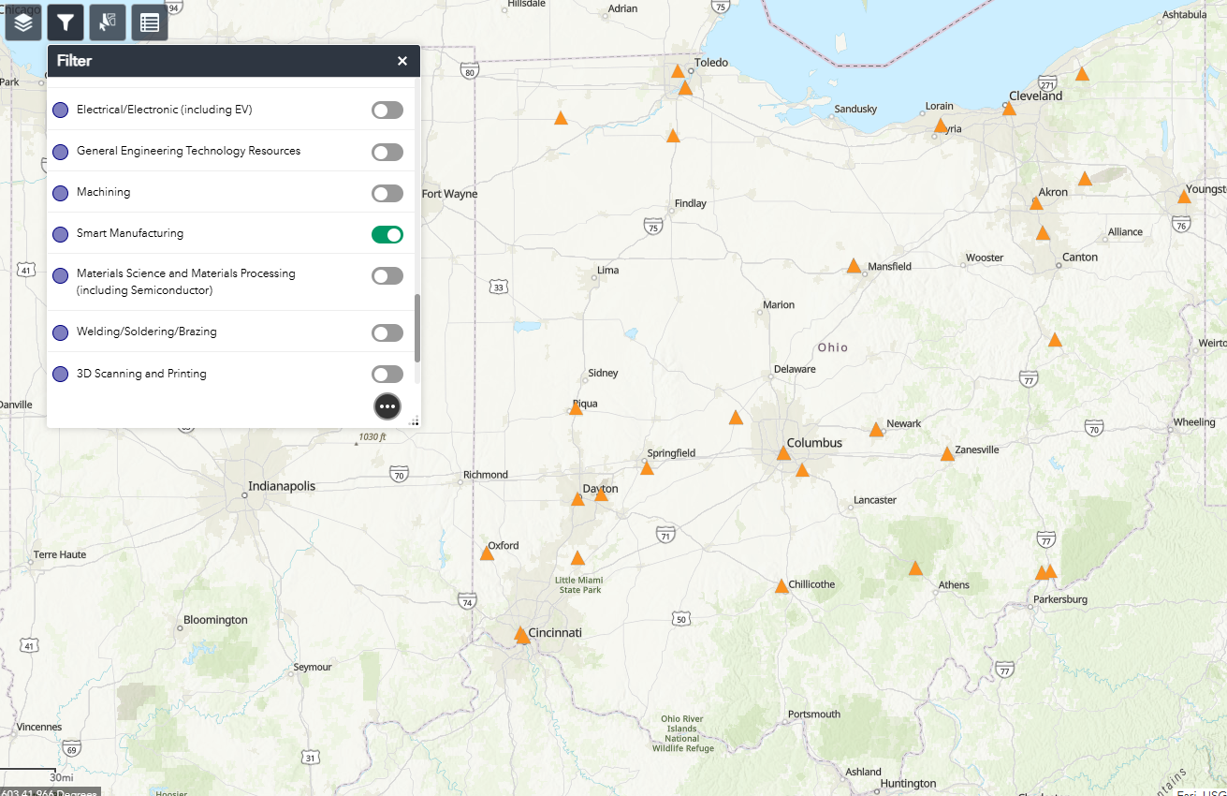

Slide 48
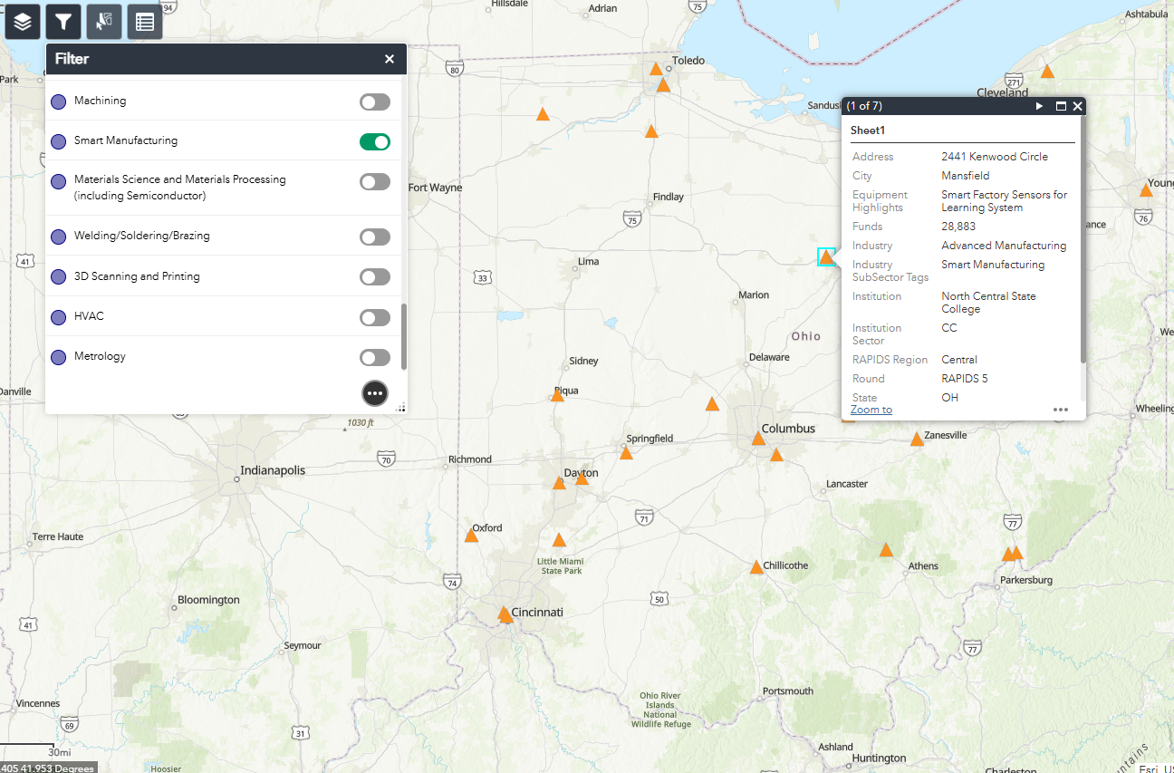

Slide 49
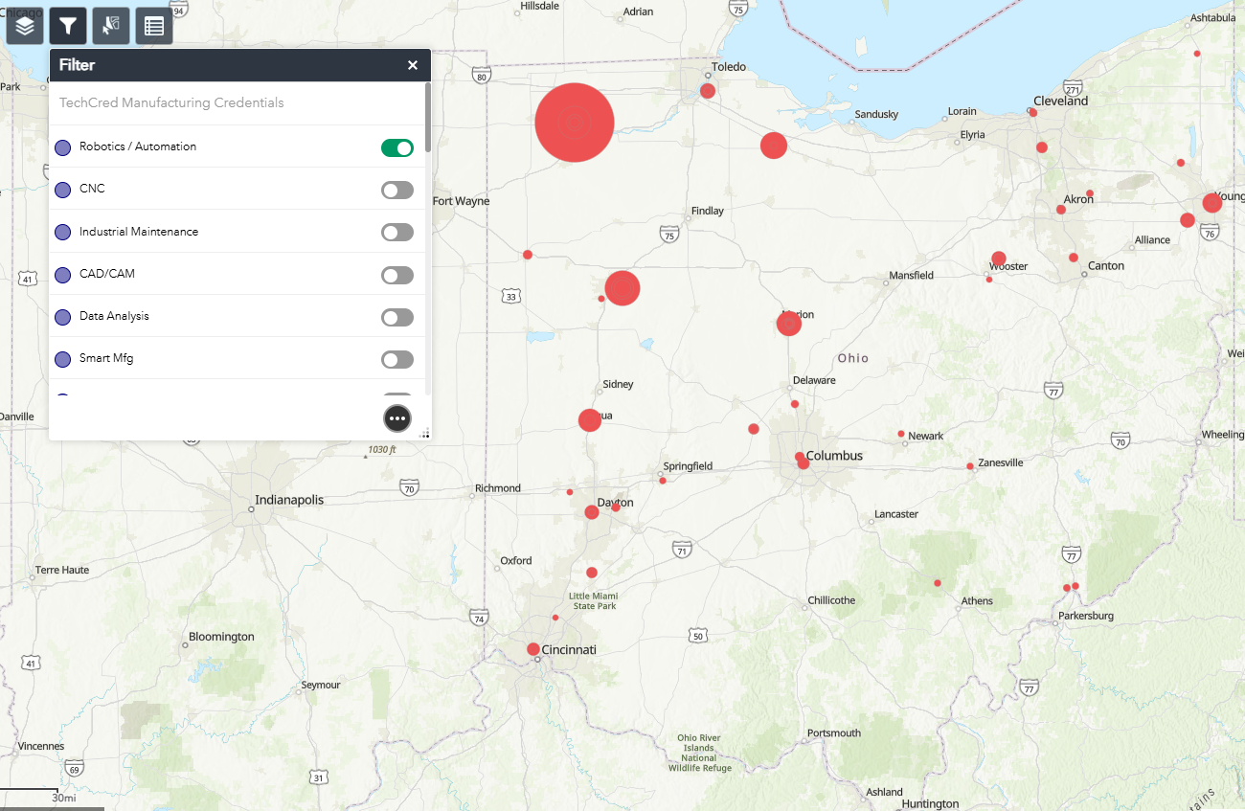

Slide 50
Technical Calculus for Engineering Technology
Built based on OSU's Technician Calculus course for BS in Engineering Technology​ (BSET)
​
Serves as a 3rd tier of technical math for programs in Advanced Manufacturing and Engineering Technology​
​
Learning Outcomes have been approved and added to the OT36: TMM 029 – Technical Calculus I
OER materials to support adoption are being assembled and developed, and a Technical Calculus II course will be explored further this academic year

Slide 51
What is your institution hiring for?
What new grants and projects has your institution started?
Share your institution's best practices, current needs, and/or ideas for collaboration
Please share any content to be included in OTN's newsletters and/or your interest in presenting at an upcoming OTN Meeting
Open Discussion
Notes:
https://oaccsuccesscenter.regfox.com/enhancing-the-engineering-technology-curriculum-aligning-omi001-introduction-to-manufacturing-and-ose001-introduction-to-semiconductors-with-oma-competencies-for-a-common-certificate-pathway

Slide 52


Partners in Training Ohio’s Manufacturing Workforce
NEXT MEETING:
October OTN Meeting
Oct. 21, 2025 at 8:30am
FOLLOW
OHIO TECHNET
ON LINKEDIN!

