Slide 1














Ohio Technical Skills Innovation Network
Ohio TechNet Monthly Meeting
JULY 2025
Date: July 15, 2025
www.ohiotechnet.org

Slide 2


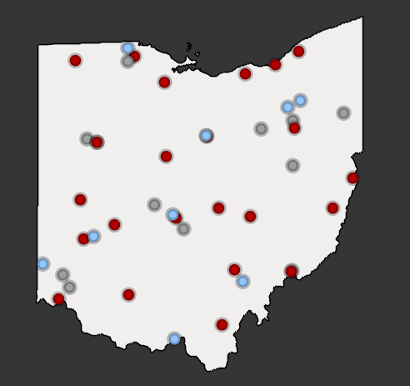


Vision
Partners in Training Ohio’s Manufacturing Workforce
The members of the Ohio Technical Skills Innovation Network, or Ohio TechNet, are nationally recognized for partnering with industry to implement collaborative, innovative solutions that meet manufacturing and tech workforce needs.
Mission
Ohio TechNet supports workforce development and academic professionals to incubate, develop and sustain programming that accelerates the growth of Ohio’s manufacturing & technical workforce.
OTN Members:
Community College
Technical Center
University
Purpose
Ohio TechNet partners benefit from peer-to-peer collaboration, technical assistance and access to resources, making program expansion and innovation at their institution more efficient, faster to implement and easier to sustain.

Slide 3
Strategic Focus
Areas
Guided Pathways for Youth
Reaching New Audiences
Innovative Earn and Learn
Faculty and Educator Development
Ohio TechNet’s strategic focus areas provide partners with best practices, models, and technical assistance to address the critical workforce needs in the state
Partnering with Industry

Slide 4

Would you rather…
Put your answer in the chat
MORNING
WARM UP
1. Sit by the pool or swim in the ocean
2. Eat s’mores or eat ice cream all summer long
3. Get a terrible sunburn or get stung by a jellyfish
4. Stay at a luxury resort or at a cabin in the woods
Notes:
Would you rather sit by the pool or swim in the ocean?
Would you rather eat s’mores or eat ice cream all summer long?
Would you rather get a terrible sunburn or get stung by a jellyfish?
Would you rather stay at a luxury resort or at a cabin in the woods?

Slide 5

Upcoming Webinar
  The Future is Now: Advanced Manufacturing in Ohio
  Tuesday, August 5, 2025
K-12 STEM Curriculum Innovation Workshop
Ohio Manufacturers Association (OMA) Workforce Development Initiatives, Lauren Massie of the Ohio Manufacturers Association (OMA)
OTN Open Discussion
  What is your institution hiring for?
  What new grants and projects has your institution started?
  Share your institution's best practices, current needs, and/or ideas for collaboration
  Please share any content to be included in OTN's newsletters and/or your interest in presenting at an upcoming OTN Meeting

Slide 6
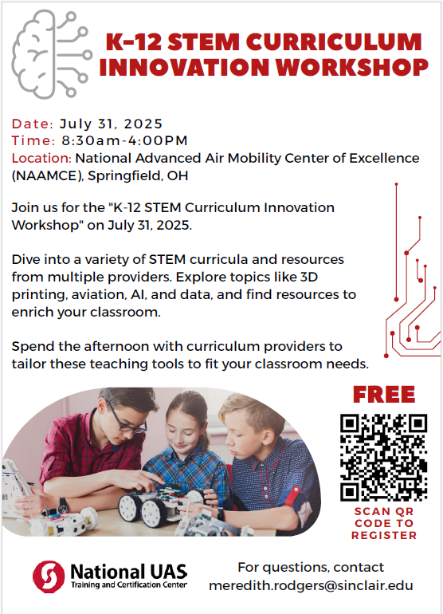
K-12 STEM Curriculum Innovation Workshop
Register Here: https://www.surveymonkey.com/r/NRTXQWZ
Notes:
https://www.surveymonkey.com/r/NRTXQWZ

Slide 7
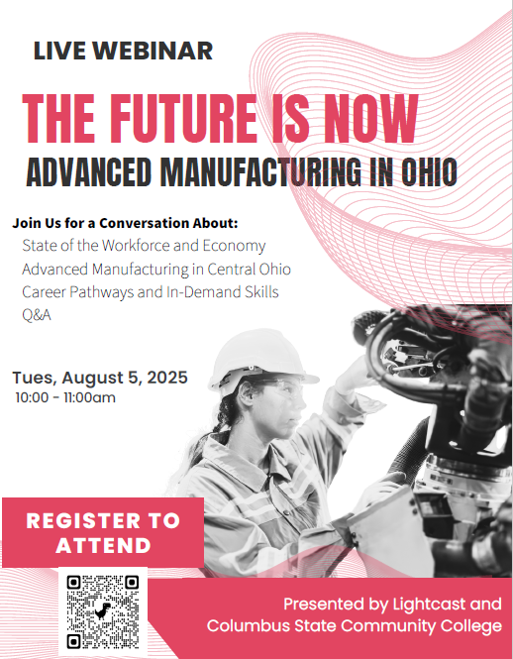
UPCOMING WEBINAR
THE FUTURE IS NOW: ADVANCED MANUFACTURING
IN OHIO
This session is designed for educators, counselors, and community influencers who are guiding young people in their career exploration. The webinar will explore:
The current and future state of the workforce and economy
The rise of advanced manufacturing in Central Ohio
Career pathways and in-demand skills
A live Q&A session with industry experts
https://vimeo.com/event/5198227/be1cf79987
Notes:
https://vimeo.com/event/5198227/be1cf79987

Slide 8
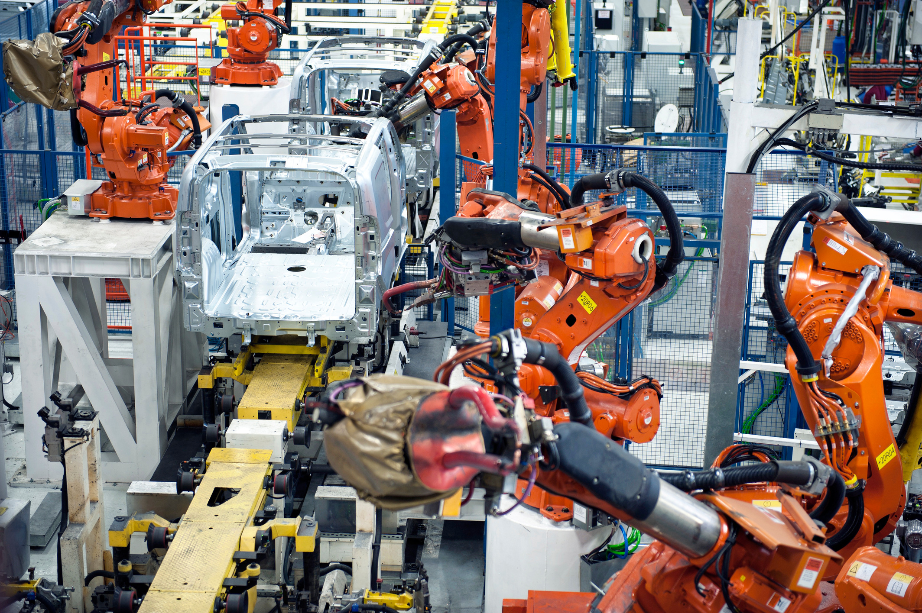


Workforce Services
Tuesday, July 15, 2025

Slide 9

AGENDA
Introduction
Strategic Priorities - Draft
K12 Outreach and Awareness
Postsecondary Stackable Career Pathways

Slide 10
Lauren Massie
Introduction
Director
Workforce Services

Slide 11
Strategic Priorities
Blueprint Draft

Slide 12
Manufacturing Workforce Blueprint Pillars - DRAFT
Each of our key priorities is represented by a pillar, the core action areas for achieving our vision, they provide a structured framework that aligns our efforts, resources, and decision-making.
How Ohio will scale a dynamic manufacturing workforce that will evolve at the pace of innovation and strengthen Ohio as a modern manufacturing powerhouse across all industries.
01
02
03
04
05
Connect Ohio Manufacturing Workforce Systems and Priorities
Supporting and accelerating regional activation with statewide alignment on initiatives and processes
Grow Manufacturing Sector Career Awareness and Interest
Promote Ohio manufacturing careers and pathways with aligned, research-based messages and stories
Broaden the Manufacturing Workforce Talent Pool
Further expand opportunities for untapped talent to access Ohio manufacturing careers, with tailored programs and services
Align & Scale Manufacturing Education and Training
Create capacity, align and optimize programming, and drive completions of programs aligned to sector needs
Expand Innovative Earn and Learn
Explore new ways to create paid on-ramps and upskilling to manufacturing careers for Ohioans
12

Slide 13
Grow Manufacturing Sector Career Awareness and Interest
Pillar 2

Slide 14
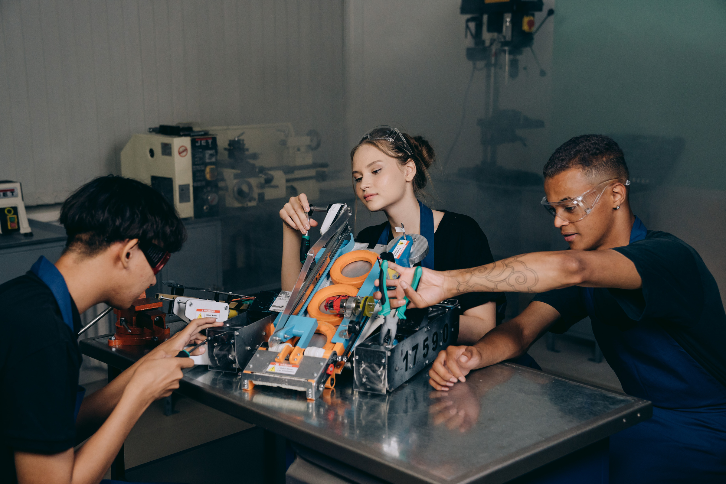
K-12 ALIGNMENT PROJECT

Slide 15


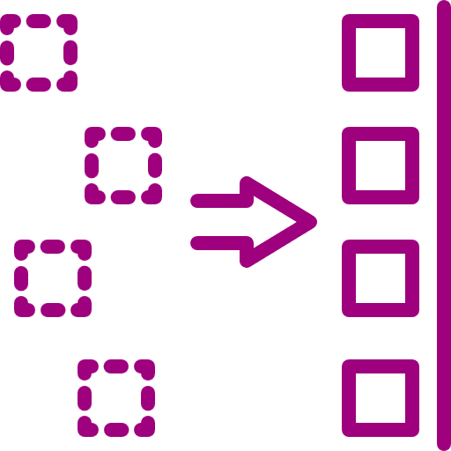


Overview
Develop strategy recommendations for Ohio Manufacturing K-12 engagement that will support long term pipeline of talent for the state’s manufacturers.
01
Catalog major assets and tools for youth outreach and engagement
Align assets and tools to Ohio’s education and career standards
02
03
Stakeholder engagement for strategic alignment
Final Deliverable: Recommendations for Aligned strategy for statewide implementation
04
Notes:
Kristy

Slide 16

Career Ambassador Program

Slide 17

COMP ISP GRANT PROJECT
  Ohio Manufacturing Career Ambassador Program Pilot
    Recruit and Train 20 manufacturer ambassadors
    Conduct 30 outreach events
    Engage with 1,000+ students and community members
  COSI Roadshow Pilot - immersive experience for kids with manufacturing and STEM
    Structured around the Ohio Manufacturing Competency Model
    Launches in Summer 2025

Slide 18
Align and Scale Manufacturing Education and Training
Pillar 4

Slide 19
Scaling the Competency Model

Slide 20
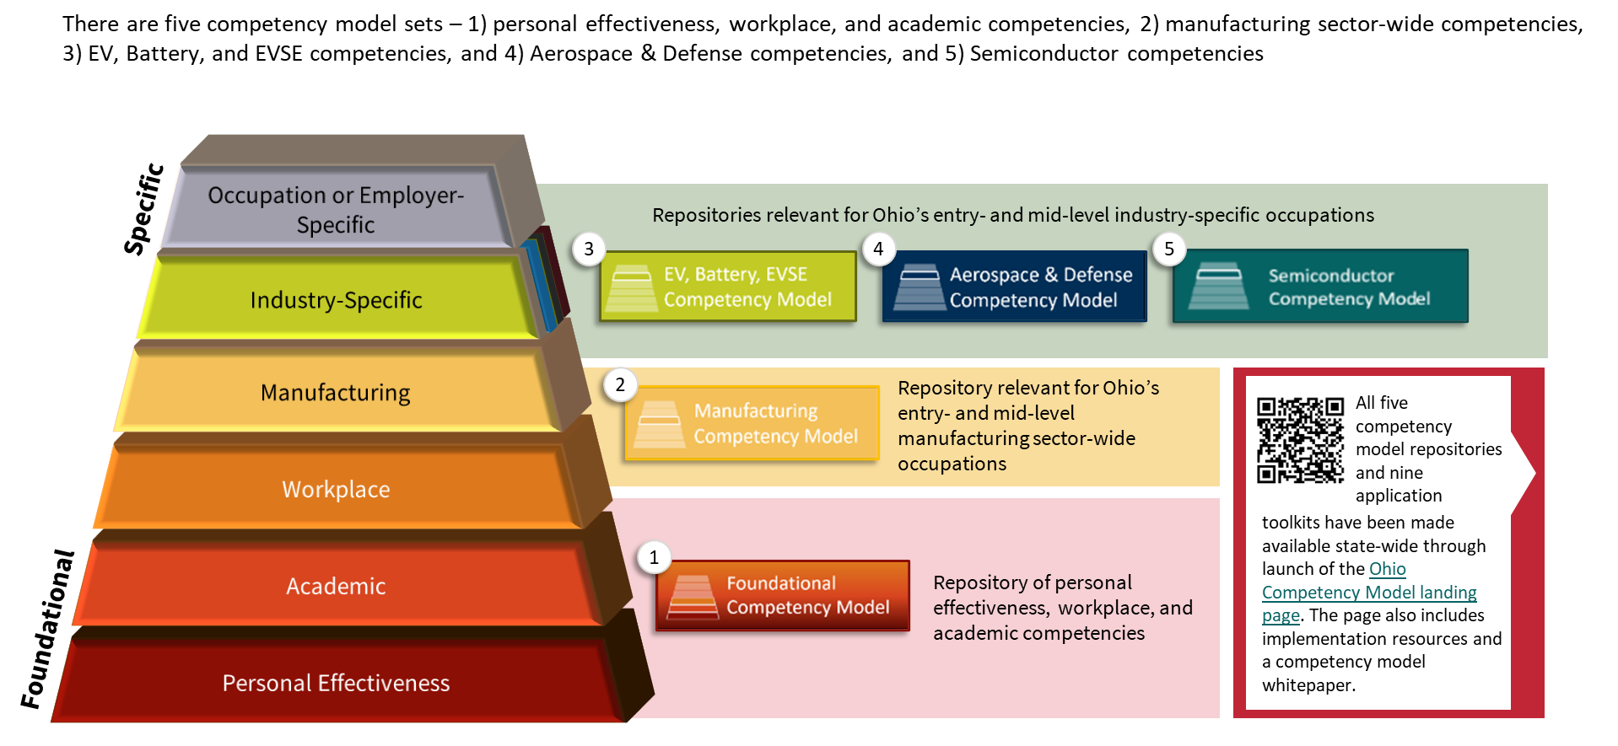
MODEL OVERVIEW - REPOSITORIES

Slide 21

SCALING THE COMPETENCY MODEL
  Digitize & Refresh the Model
  All Ohio Technical Centers Conduct Assessments of Aligned Programs
    By December 2025
      So Far: 15 out of 42 OTCs Completed
  All 22 Community Colleges Conduct Assessments of Aligned Programs
    By June 2026
      So Far: 12 out of 22 Colleges Completed

Slide 22
Design and Optimize Stackable Credential Pathways

Slide 23
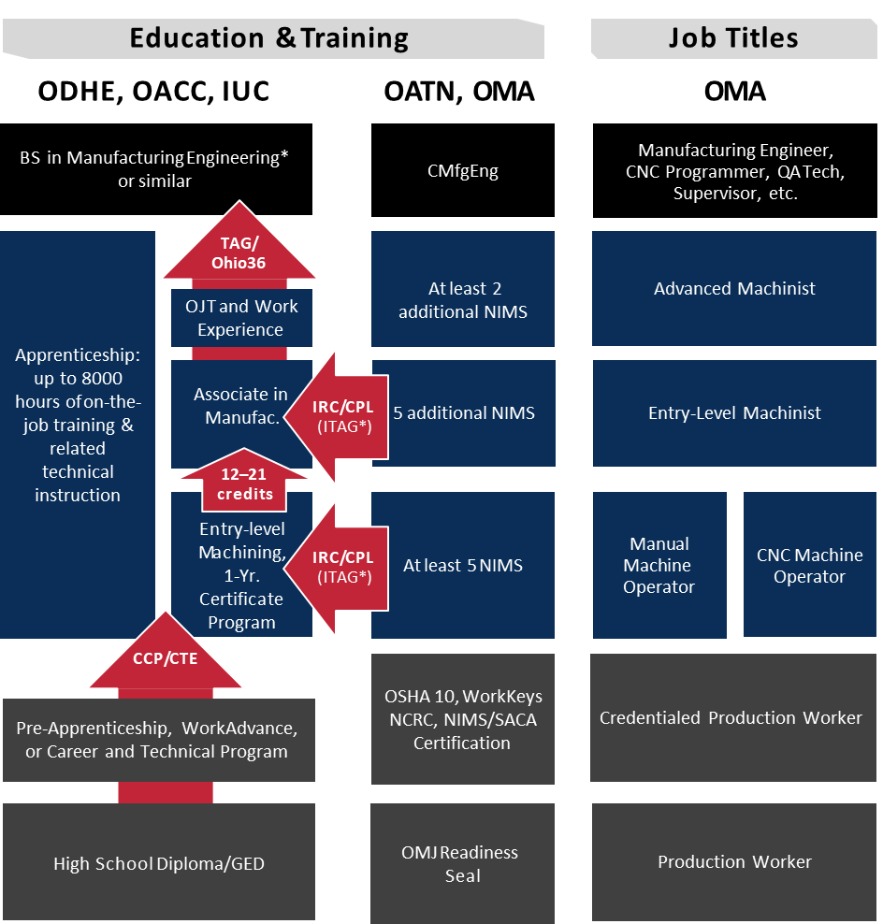
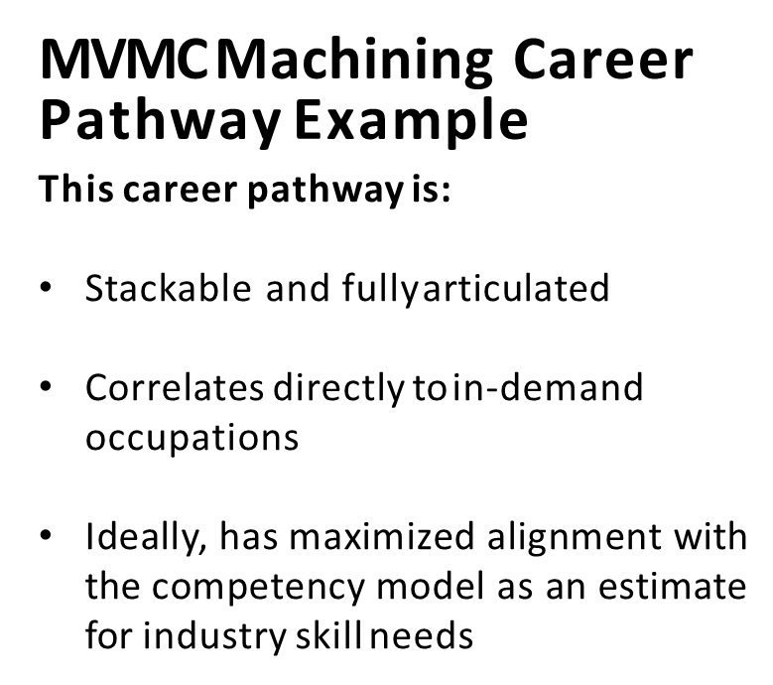

WHAT WE WANT TO CREATE

Slide 24
SCALING THE COMPETENCY MODEL
  Design & Optimize Stackable Credential Pathways
    ODEW Standards
    ITAGs/CTAGs/MTAGs Credential Alignment
    Connecting K12 and OTC pathways to credit options
    OACC Course Redesign

Slide 25

THANK YOU

Slide 26
What is your institution hiring for?
What new grants and projects has your institution started?
Share your institution's best practices, current needs, and/or ideas for collaboration
Please share any content to be included in OTN's newsletters and/or your interest in presenting at an upcoming OTN Meeting
Open Discussion
Notes:
https://oaccsuccesscenter.regfox.com/enhancing-the-engineering-technology-curriculum-aligning-omi001-introduction-to-manufacturing-and-ose001-introduction-to-semiconductors-with-oma-competencies-for-a-common-certificate-pathway

Slide 27


Partners in Training Ohio’s Manufacturing Workforce
NEXT MEETING:
NO AUGUST MEETING
FOLLOW
OHIO TECHNET
ON LINKEDIN!
September OTN Meeting
Sep 16, 2025 at 8:30am

